Slide 1
Catan: Deep Q-Learning
Double-Deep Q-Learning in a Multi-Agent Doubly-Stochastic,
High Dimensional, Multi-Incongruent-Channel Setting
Adam Mann (aim2127)

Slide 2

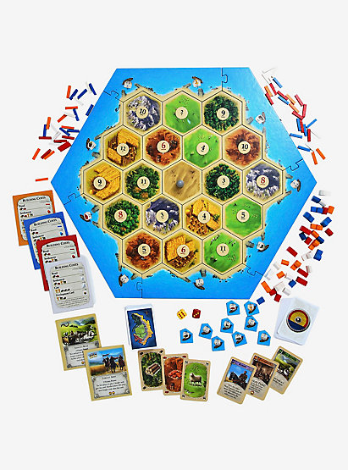
Basics of the Game
Multi-player (3-4) stochastic Eurogame
Board consists of 19 tiles, 54 vertices, and 72 edges.
Goal is to get ten points.
This is done by collecting cards, which are gained by rolling dice and obtaining a number on a tile adjacent to one’s settlements.
Cards are then used to build roads, settlements, and cities or buy development cards.

Slide 3
Less Basic Rules
One can trade cards with other players
If a seven is rolled players with more than 7 cards must dropped half of there cards (round down)
When a seven is rolled (or knight played) the current player gets to move the robber to a new tile and a take a random card from a player on that tile.
Cards can be traded in at 4:1, unless the player has a special port.
Development cards can either be point cards, a knight, help build roads, steal cards from other players, or allow you to take any two resources.
At the start all players build two settlements and two roads.

Slide 4
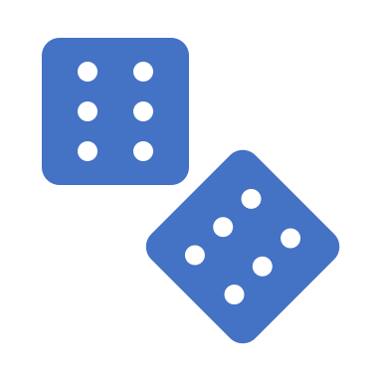
Why Catan?
Multi-Agent
Doubly Stochastic (available actions and results)
Difficult to represent
Large state space
No one has made a competitive Agent yet
Why not?

Slide 5
Literature Review: Catan AIs
J-Settlers (2005): Heuristic agent used in commercial Catan applications
Pfeiffer (2004): Model Tree AI agent never beats a human agent. (Avg 6pts a game)
Szita, Chaslot, Spronck (2010): Monte-Carlo Tree Search based agent beats J-Settlers after playing 10,000 games a turn. Even with their expensive set up a game takes 2 hours to play.
Gendre, Kaneko (2019): Apply Cross-Dimensional Neural Networks and Actor-Critic. Beat J-Settlers after 3 weeks of training but the game is limited to 2 players

Slide 6
Literature Review: Deep Q-Learning and Multi-Agent Settings
DeepMind (2015): Double Deep Q-Learning increases learning stability in most Atari games
Egorov (2016): Recommends using one network for Multi-Agent Reinforcement Learning, representing self and opponents in different channels
Google Research (2018): Found no significant effect of applying standard Q-Learning techniques to stochastic action spaces

Slide 7
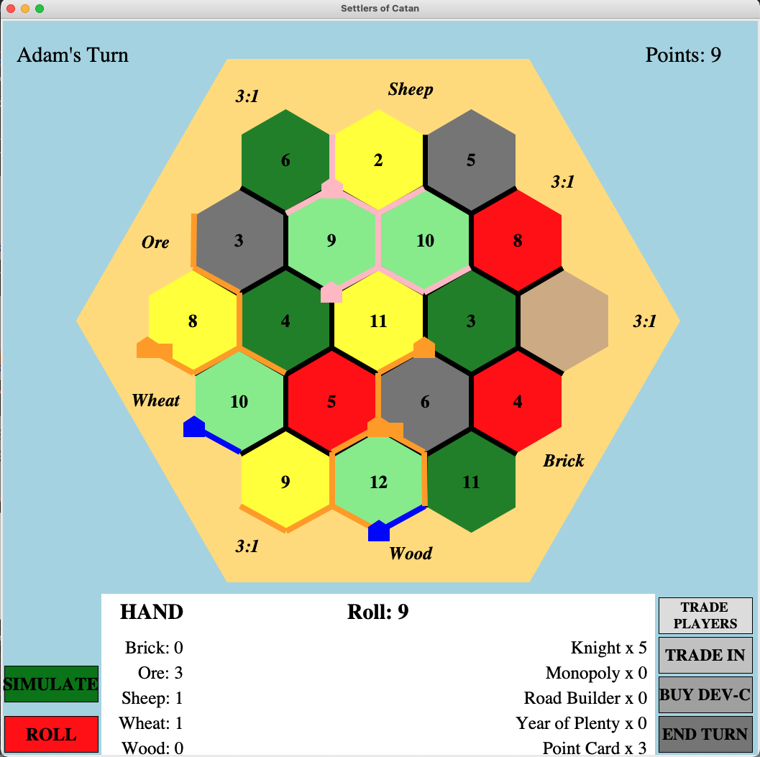
Environment
Game logic and objects built in Python
GUI built in Tkinter
Verification of correct implementation by hand play
AI agent’s action space is limited
Cannot trade with others
Cannot control which cards to drop
Limit to one layout of the board
AI is trained without the GUI
Neural network implemented in Keras and trained on an AMD Radeon GPU

Slide 8
The RL Agent
Double Deep Q- Learning:
Large number of possible states to estimate
Not yet done in the literature
Neural Network Design:
Ablation studies with different architectures and state representations (to be further discussed)
Catan is rare in that the entire action space cannot be determined by the board alone

Slide 9
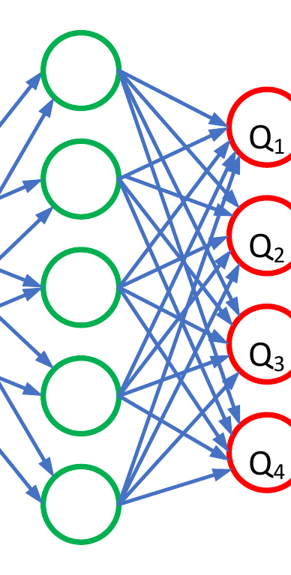
Double Deep Q-Learning
Soft Update of Target Network
32-batches of training for each action
Rewards based on moves taken as well as length of the game (the faster the win the more reward)
As the action space cannot be directly represented the network is passed the state representation of the state` that results from the associated action
The Q-Network learns from all the players
This Photo by Unknown Author is licensed under CC BY-SA

Slide 10
State Representations and Performance: Version #1
Development
Cards
Resource
Cards
Road
Locations
# of Played
Knights
Settlement and Knight
Locations
-14 27x27 channels
-Similar to the methodology used by DeepMind
-Uses a CNN as the QNetwork
-After 200 rounds of training never finishes a game within 110 rounds (competitive is under 40)

Slide 11
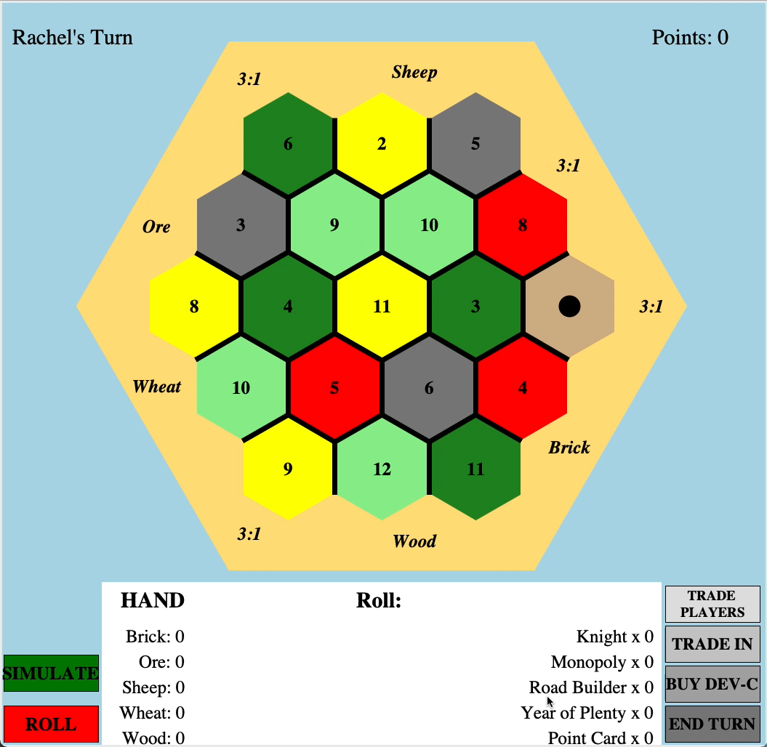

Slide 12
Version #1: Issues
Fails to properly use the robber
Tends to build in sub-par areas
Continuously trades in cards losing good building opportunities
Roads are all over the place

Slide 13
State Representations and Performance: Version #2
Vertex 1
-More traditional network
-Simpler state space representation
-Faster to train
-Loses locational information
-Trained for 500 games
Vertex 2
Point cards
Played Knights

Slide 14


Slide 15
Version #2: Issues and Improvements
Good robber movement
Tends to build in sub-par areas
Prioritizes building
Roads are all over the place
Improvements
Issues

Slide 16
State Representations and Performance: Version #3
Resource Cards, Development cards,
Knights Played
Combines the two previous approaches
Maintain locational data while simplifying other data
Splitting Roads from Settlements avoids confusion for the network
Trained for 200 games
Roads (All Players)
Settlements, cities, and Robber (All Players

Slide 17


Slide 18
Version #3: Issues and Improvements
Good robber movement
Doesn’t play knights
Could build more
Excellent placement

Slide 19
Grid Representation
 |  | V | R | V | R | V
 |  | R |  |  |  | R
V | R | V | R | V | R | V
R |  |  |  | R
V | R | V | R | V
 |  |  |  | V
 |  |  | R |  | R
 |  | V |  |  |  | V
 |  | R |  |  |  | R
 |  | V |  |  |  | V
 | R |  | R |  | R
V |  |  |  | V
R |  |  |  | R
V |  |  |  | V
 | R |  | R
 |  | V
-Used in Gendre, Kaneko (2019):
-Seemed to result in skewed policies in which agents performed building on the side
-Representing the grid in the original honeycomb structure performed the best

Slide 20
Next Steps
Learning to play knights. On average games would last for 20 rounds fewer, making it competitive with a person.
Improve stability in training.
Deploy the game to see how it does against real people

Slide 21
Agents compete better over time

